Slide 1
e-Commerce Applications and Issues
E-commerce is here to stay. The Web and e-commerce are key industry drivers. It's changed how many companies do business. It's created new channels for our customers. Companies are at the e-commerce crossroads and there are many ways to go

Slide 2
Business-to-Consumer e-Commerce
E-commerce applications that focus on the consumer share an important goal: to attract potential buyers, transact goods and services, and build customer loyalty through individual courteous treatment and engaging community features.

Slide 3
What does it take to create a successful B2C e-commerce business venture? That's the question that many are asking in the wake of the failures of many pure B2C dot­com companies.
One obvious answer would be to create a Web business initiative that offers attractive products or services of great customer value, and whose business plan is based on realistic forecasts of profitability within the first year or two of operation - a condition that was lacking in many failed dot-coms.
But such failures have not stemmed the tide of millions of businesses, both large and small, that are moving at least part of their business to the Web. So let's take a look at some essential success factors and website capabilities for companies engaged in either B2C or B2B e­commerce.

Slide 4
Below are examples of a few top-rated retail Web companies.
Top Retail Website
• Amazon.com
www.amazon.com
Amazon.com is the exception to the rule that consumers prefer to shop "real world"
retailers online. The mother of all shopping sites, Amazon features a vast selection of
books, videos, DVDs, CDs, toys, kitchen items, electronics, and even home and garden
goods sold to millions of loyal customers.
• eBay
www.ebay.com
The fabled auction site operates the world's biggest electronic flea market, with everything
from antiques, computers, and coins to Pez dispensers and baseball cards. This site
boasts billions of page views per month, and millions of items for sale in thousands of
categories supported by thousands of special-interest groups.
• Eddie Bauer
www.eddiebauer.com
Sportswear titan Eddie Bauer has integrated its retail channels-store, website, and cata-
log. Shoppers can return an item to any Eddie Bauer store, no matter where it was pur-
chased-a policy other merchants should follow.
• Lands' End
www.landsend.com
With several seasons as an online retailer, Lands' End is a pro at meeting shoppers'
expectations. One of the best features: Specialty Shoppers. A customer service rep will
help you make your selections and answer questions by phone or via a live chat.

Slide 5
e-Commerce Success Factors
On the Internet, the barriers of time, distance, and form are broken down, and businesses are able to transact the sale of goods and services 24 hours a day, 7 days a week, 365 days a year with consumers all over the world. In certain cases, it is even possible to convert a physical good (CDs, packaged software, a newspaper) to a virtual good (MP3 audio, downloadable software, information in HTML format)

Slide 6
A basic fact of Internet retailing is that all retail websites are created equal as far as the "location, location, location" imperative of success in retailing is concerned.
No site is any closer to its Web customers and competitors offering similar goods and services may be only a mouse click away.
This makes it vital that businesses find ways to build customer satisfaction, loyalty, and relationships, so customers keep coming back to their Web stores.

Slide 7
Thus the key to e-tail success is to optimize several key factors such as
selection and value,
performance and service efficiency,
the look and feel of the site,
advertising and incentives to purchase,
personal attention,
community relationships, and
security and reliability.
Let's briefly examine each of these factors that are essential to the success of a B2C Web business. See Figure below.

Slide 8
e-Commerce Success Factors
• Selection and Value. Attractive product selections, competitive prices, satisfaction
guarantees, and customer support after the sale.
• Performance and Service. Fast, easy navigation, shopping, and purchasing, and prompt
shipping and delivery.
• Look and Feel. Attractive Web storefront, website shopping areas, multimedia product
catalog pages, and shopping features.
• Advertising and Incentives. Targeted Web page advertising and e-mail promotions,
discounts and special offers, including advertising at affiliate sites.
• Personal Attention. Personal Web pages, personalized product recommendations, Web
advertising and e-mail notices, and interactive support for all customers.
• Community Relationships. Virtual communities of customers, suppliers, company
representatives, and others via newsgroups, chat rooms, and links to related sites.
• Security and Reliability. Security of customer information and website transactions,
trustworthy product information, and reliable order fulfillment.

Slide 9
Selection and Value.
Obviously, a business must offer Web shoppers a good selection of attractive products and services at competitive prices or they will quickly click away from a Web store.
But a company's prices don't have to be the lowest on the Web if they build a reputation for
high quality,
guaranteed satisfaction, and
top customer support while shopping and after the sale.

Slide 10
Performance and Service.
People don't want to be kept waiting when browsing, selecting, or paying in a Web store.
A site must be efficiently designed for ease of
access,
shopping, and
buying, with
sufficient server power and
network capacity to support website traffic.
Web shopping and customer service must also be
friendly and helpful, as well as
quick and easy.
In addition, products offered should be available in inventory for prompt shipment to the customer.

Slide 11
Look and Feel. B2C sites can offer customers an attractive Web storefront, shop­ping areas, and multimedia product catalogs.
These could range from an exciting shopping experience with audio, video, and moving graphics, to a more simple and comfortable look and feel.
Thus, most retail e-commerce sites let customers browse product sections, select products, drop them into a virtual shopping cart, and go to a virtual checkout station when they are ready to pay for their order.

Slide 12
Advertising and Incentives. Some Web stores may advertise in traditional media, but most advertise on the Web with targeted and personalized banner ads and other Web page and e-mail promotions.
Most B2C sites also offer shoppers incentives to buy and return. Typically, this means
coupons,
discounts,
special offers,
and vouch­ers for other Web services, sometimes with other e-tailers at cross-linked websites.
Many Web stores also increase their market reach by being part of Web banner advertising exchange programs with thousands of other Web retailers

Slide 13
Personal Attention. Personalizing your shopping experience encourages you to buy and make return visits. Thus, e-commerce software can automatically record details of your visits and build user profiles of you and other Web shoppers.
Many sites also encourage you to register with them and fill out a personal interest profile. Then, whenever you return, you are welcomed by name or with a personal Web page, greeted with special offers, and guided to those parts of the site that you are most interested in.

Slide 14
Community Relationships. Giving online customers with special interests a feel­ing of belonging to a unique group of like-minded individuals helps build customer loyalty and value.
Thus, website relationship and affinity marketing programs build and promote virtual communities of customers, suppliers, company representatives, and others via a variety of Web-based collaboration tools.
Examples include
discus­sion forums or newsgroups,
chat rooms,
message board systems, and cross-links to related website communities.

Slide 15
Security and Reliability. As a customer of a successful Web store, you must feel confident that your credit card, personal information, and details of your transac­tions are secure from unauthorized use.
You must also feel that you are dealing with a trustworthy business, whose products and other website information you can trust to be as advertised.
Having your orders filled and shipped as you requested, in the time frame promised, and with good customer support are other measures of an e-tailer's reliability.

Slide 16
Web Store Requirements
Most business-to-consumer e-commerce ventures take the form of retail business sites on the World Wide Web.
Whether huge or small, the primary focus of such e-tailers is to develop, operate, and manage their websites so they become high-priority destinations for consumers who will repeatedly choose to go there to buy products and services.
The essential Web store requirements that you would have to implement to support a successful retail business on the Web, are summarized and illustrated in the next table.

Slide 17
 | Developing a Web store
• Build Website design tools Site design templates Custom design services Website hosting | • Market Web page advertising E-mail promotions Web advertising exchanges with affiliate sites Search engine registrations
 | Serving Your Customers
• Serve Personalized Web pages Dynamic multimedia Catalog search engine Integrated shopping cart | Transact Flexible order process Credit card processing Shipping and tax calculations E-mail order notifications | • Support Website online help Customer service e-mail Discussion groups and chat rooms Links to related sites
 | Managing a Web Store
• Manage Website usage statistics Sales and inventory reports Customer account management Links to accounting system | • Operate 24x7 website hosting Online tech support Scalable network capacity Redundant servers and power | • Protect User password protection Encrypted order processing Encrypted website administration Network firewalls and security monitors
These Web store requirements must be implemented by a company or its website hosting service, in order to develop a successful e-commerce business.

Slide 18
Developing a Web Store
Many companies use
simple website design software tools and predesigned templates provided by their website hosting service to construct their Web retail store. That includes
building your Web storefront and product catalog Web pages,
as well as tools to provide shopping cart features,
process orders,
handle credit card payments, and so forth.
Of course, larger companies can use their own software developers or hire an outside website development contractor to build a custom­designed e-commerce site.
Also, like most companies, you can contract with your ISP (Internet service provider) or a specialized Web hosting company to operate and maintain your B2C website.

Slide 19
Once you build your website, it must be developed as a retail Web business by marketing it in a variety of ways e.g. through
Web page and e-mail advertising and promotions for Web visitors and customers, and
Web advertising exchange programs with other Web stores.
Also, you can register your Web business with its own domain name (for example, yourstore.com),
as well as registering your website with the major Web search engines and directories to help Web surfers find your site more easily.

Slide 20
In addition, you might consider affiliating as a small business partner with
large Web portals like Yahoo! and Netscape,
large e-tailers and auction sites like Amazon and eBay, and
small business Web centers like Microsoft bCentral and Prodigy Biz.

Slide 21
Serving your Customers
Once your retail store is on the Web and receiving visitors, the website must help you welcome and serve them personally and efficiently so that they become loyal customers.
So most e-tailers use several website tools to create
user profiles,
customer files, and
personal Web pages and promotions
that help them develop a one-to-one relationship with their customers.

Slide 22
This includes
creating incentives to encourage visitors to register,
developing Web cookie files to automatically identify returning visitors, or
contracting with website tracking companies like DoubleClick and others for software to automatically record and analyze the details of the website behavior and preferences of Web shoppers.

Slide 23
The website should also have the look and feel of an attractive, friendly, and efficient Web store.
That means having e-commerce features like
a dynamically changing and updated multimedia catalog,
a fast catalog search engine, and
a convenient shopping cart system that is integrated with
promotions,
payment,
shipping, and
customer account information.

Slide 24
Your e-commerce order processing software should be
fast and able to adjust to personalized promotions and customer options like
gift handling,
special discounts,
credit card or other payments, and
shipping and tax alternatives.
Also, automatically sending your customers e-mail notices to document when orders are processed and shipped is a top customer service feature of e-tail transaction processing.

Slide 25
Providing customer support for your Web store is an essential website capability.
So many e-tail sites offer help menus, tutorials, and lists of FAQs (frequently asked questions) to provide self-help features for Web shoppers.
Of course, e-mail correpondence with customer service representatives of your Web store offers more personal assistance to customers.
Establishing website discussion groups and chat rooms for your customers and store personnel to interact helps create a more personal community that can provide invaluable support to customers, as well as building customer loyalty.

Slide 26
Providing links to related websites from your Web store can help customers find additional information and resources, as well as earning commission income from the affiliate marketing programs of other Web retailers.
For example, the Amazon.com Affiliate program pays commissions of up to 15 percent for purchases made by Web shoppers clicking to their Web store from your site.

Slide 27
Managing a Web Store
A Web retail store must be managed as both a business and a website, and most e-commerce hosting companies offer software and services to help you do just that.
For example, companies like Freemerchant, Prodigy Biz, and Verio provide their hosting clients with a variety of management reports that record and analyze Web store traffic, inventory, and sales results.
Other services build customer lists for e-mail and Web page promotions, or provide customer relationship management features to help retain Web customers.
Also, some e-commerce software includes links to download inventory and sales data into accounting packages like QuickBooks for bookkeeping and preparation of financial statements and reports.

Slide 28
Of course, Web hosting companies must enable their Web store clients to be available online twenty-four hours a day and seven days a week all year.
This requires them to build or contract for sufficient network capacity to handle peak Web traffic loads, and redundant network servers and power sources to respond to system or power failures.
Most hosting companies provide e-commerce software that uses passwords and encryption to protect Web store transactions and customer records, and employ network firewalls and security monitors to repel hacker attacks and other security threats.
Many hosting services also offer their clients 24-hour tech support to help them with any technical problems that arise.

Slide 29
Business-to-Business e-Commerce
Business-to-business electronic commerce is the wholesale and supply side of the commercial process, where businesses buy, sell, or trade with other businesses.
B2B electronic commerce relies on many different information technologies, most of which are implemented at e-commerce websites on the World Wide Web and corporate intranets and extranets.

Slide 30
B2B applications include
electronic catalog systems,
electronic trading systems such as exchange and auction portals,
electronic data interchange,
electronic funds transfers, and so on.
All of the factors for building a successful retail website we discussed earlier also apply to wholesale websites for business-to-business electronic commerce.

Slide 31
In addition, many businesses are integrating their Web-based e-commerce systems with their e-business systems for
supply chain management,
customer relationship management, and
online transaction processing, as well as to their
traditional, or legacy, computer-based accounting and business information systems.
This ensures that all electronic commerce activities are integrated with e-business processes and supported by up-to-date corporate inventory and other databases, which in turn are automatically updated by Web sales activities.

Slide 32
Electronic Data Interchange
Electronic data interchange (EDI) was one of the earliest uses of information technology for electronic commerce.
EDI involves the electronic exchange of business transaction documents over the Internet and other networks between supply chain trading partners (organizations and their customers and suppliers).

Slide 33
Data representing a variety of business transaction documents (such as purchase orders, invoices, requests for quotations, and shipping notices) are automatically exchanged between computers using standard document message formats.

Slide 34
Typically, EDI software is used to convert a company's own document formats into standardized EDI formats as specified by various industry and international protocols.
Thus, EDI is an example of the almost complete automation of an e-commerce supply chain process.
And EDI over the Internet, using secure virtual private networks, is a growing B2B e-commerce application.

Slide 35
Formatted transaction data are transmitted over network links directly between computers without paper documents or human intervention.
Besides direct network links between the computers of trading partners, third-party services are widely used.
Value-added network companies like GE Global Exchange Services and Computer Associates offer a variety of EDI services for relatively high fees.
But many EDI service providers now offer secure, lower cost EDI services over the Internet. The next figure illustrates a typical EDI system

Slide 36
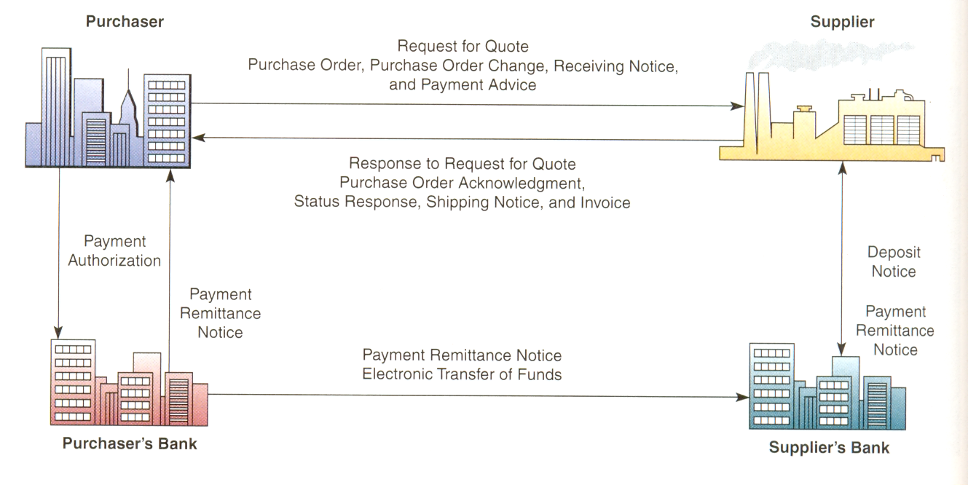

Slide 37
EDI is still a popular data-transmission format among major trading partners, primarily to automate repetitive transactions, though it is slowly being replaced by XML­based Web services.
EDI automatically tracks inventory changes; triggers orders, invoices, and other documents related to transactions; and schedules and confirms delivery and payment.

Slide 38
By digitally integrating the supply chain, EDI streamlines processes, saves time, and increases accuracy. And by using Internet technologies, lower cost Internet-based EDI services are now available to smaller businesses

Slide 39
Clicks and Bricks in e-Commerce
Companies are recognizing that success will go to those who can execute clicks-and-­mortar strategies that bridge the physical and virtual worlds. Different companies will need to follow very different paths in deciding how closely - or loosely - to integrate their Internet initiatives with their traditional operations

Slide 40
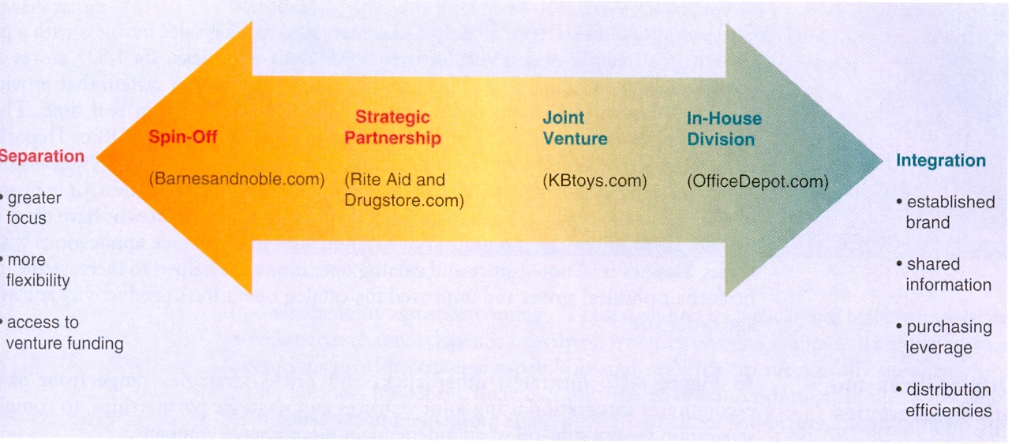
Companies have a spectrum of alternatives and benefits trade-offs when deciding upon an integrated or separated e-commerce business.

Slide 41
Should we integrate our e-commerce virtual business operations with our traditional physical business operations, or keep them separate?
The business case for such strategies rests on:
Capitalizing on any unique strategic capabilities that may exist in a company's traditional business operations that could be used to support an e-commerce business.
Gaining several strategic benefits of integrating e-commerce into a company's traditional business; such as the sharing of established brands and key business information, and joint buying power and distribution efficiencies.

Slide 42
Clicks and bricks strategies range from
partial e-commerce integration using joint ventures and strategic partnerships, to
complete separation via the spin-off of an independent e-commerce company.

Slide 43
For example, Office Depot already had a successful catalogue sales business with a professional call centre and a fleet of over 2,000 delivery trucks. Its 1,825 stores and 30 warehouses were networked by a sophisticated information system that provided complete customer, vendor, order, and product inventory data in real time. These business resources made an invaluable foundation for coordinating Office Depot’s e­commerce activities and customer services with its catalogue business and physical stores.

Slide 44
Thus, customers can shop at OfficeDepot.com at their home or business, or at in-store kiosks. Then they can choose to pick up their purchases at the stores or have them de­livered. In addition, the integration of Web-enabled e-commerce applications within Office Depot’s traditional store and catalog operations has helped to increase the traf­fic at their physical stores and improved the catalog operation’s productivity and aver­age order size

Slide 45
Other Click and Brick Strategies.
As the above figure illustrates other clicks and bricks strategies range from partial e-commerce integration using joint ventures and strategic partnerships, to complete separation via the spin-off of an independent e-commerce company.
For example, Kbtoys.com is an e-commerce joint venture of KB Online Holdings LLC, created by toy retailer KB Toys and BrainPlay.com, formerly an e-tailer of chil­dren’s products. The company is 80 percent owned by KB Toys, but has independent management teams and separate distribution systems.

Slide 46
However, Kbtoys.com has suc­cessfully capitalized on the shared brand name and buying power of KB Toys, and the ability of its customers to return purchases to over 1,300 KB Toys stores which also heavily promote their e-commerce site.

Slide 47
However, Kbtoys.com has suc­cessfully capitalized on the shared brand name and buying power of KB Toys, and the ability of its customers to return purchases to over 1,300 KB Toys stores which also heavily promote their e-commerce site.

Slide 48
The strategic partnership of the Rite-Aid retail drugstore chain and Drugstore.com is a good example of a less integrated e-commerce venture.
Rite-Aid only owns about 25 percent of Drugstore.com, which has an independent manage­ment team and a separate business brand. However, both companies share the de­creased costs and increased revenue benefits of joint buying power, an integrated distribution center, co-branded pharmacy products, and joint prescription fulfillment at Rite-Aid stores.

Slide 49
Finally, a completely sep­arate clicks and bricks strategy.
Barnesandnoble.com was created as an independent e­commerce company that was spun off by the Barnes & Noble book retail chain. This enabled it to gain several hundred million dollars in venture capital funding, create an entrepreneurial culture, attract quality management, maintain a high degree of busi­ness flexibility, and accelerate decision making.

Slide 50
But the book e-retailer has done poorly since its founding, and has failed to gain market share from Amazon.com, its leading competitor. Many business analysts say that the failure of Barnes & Noble to integrate some of the marketing and operations of Barnesandnoble.com within their thousands of bookstores forfeited a key strategic business opportunity

Slide 51
e-Commerce Channel Choices
An e-commerce channel is the marketing or sales channel created by a company to conduct and manage its chosen e-commerce activities.
How this e-commerce channel is integrated with a company's traditional sales channels
(retail/wholesale outlets,
catalog sales,
direct sales, etc.)
is a major consideration in developing its e-commerce strategy

Slide 52
Some of the key questions that the management of companies must answer in making a clicks and bricks decision and developing the resulting e-commerce channel are out­lined in the figure on the next slide.

Slide 53
A Checklist for Channel Development
What audiences are we attempting to reach?
What action do we want those audiences to take?-to learn about us, to give us infor­mation about themselves, to make an inquiry, to buy something from our site, to buy something through another channel?
Who owns the e-commerce channel within the organization?
Is the e-commerce channel planned alongside other channels?
Do we have a process for generating, approving, releasing, and withdrawing content?
Will our brands translate to the new channel or will they require modification?
How will we market the channel itself?

Slide 54
There is no universal clicks and bricks e-commerce strategy or e-commerce channel choice for every company, industry, or type of business.
Both e-commerce integration and separation have major business benefits and shortcomings.
Thus, deciding on a clicks and bricks strategy and e-commerce channel depends heavily on whether or not a company's unique business operations provide strategic capabilities and resources to successfully support a profitable business model for their e-commerce channel.

Slide 55
As these examples show, most companies are implementing some measure of clicks and bricks integration, because "the benefits of integration are almost always too great to abandon entirely"

